Slide 2
Prajod Vettiyattil
Software Architect

Slide 3
Pushing the limits of Generative AI
Using Azure OpenAI for Retail Planogram Design

Slide 4
Overview
What is Generative AI
What it can do
What it cannot do
Retail stores and planograms
Business challenges in planogram design
Designing planograms using GenAI
Hierarchical and Tabular data sets
Combining all the techniques

Slide 5

What is Generative AI
AI that “generates” stuff
Text, images, videos
Prompt: “Generate image of a playful puppy”
Generative vs Discriminative
Discriminative
Is this a cat ?
Transformers
Large Language Models
Source: rawpixel.com
Notes:
https://www.rawpixel.com/image/12057067/png-white-background-dog

Slide 6
What can it do
Generate all types of content based on your prompt
Input: text, image, video
Output: text, image, video
Output is based on input + current output
Context, Role, Conversation

Slide 7
What it cannot do(as of now !)
External integration
Long conversations
Discontinuous text
Tabular
Hierarchical
Mathematical calculations
Visual ordering from textual inputs
Top Left
Top Right
Bottom Left
Bottom Right

Slide 8
What are we trying to solve
Connect LLMs and Enterprise Data
This is not Retrieval Augmented Generation
LLM
Enterprise Data
XL sheets
Use data
Understand data
Databases

Slide 9
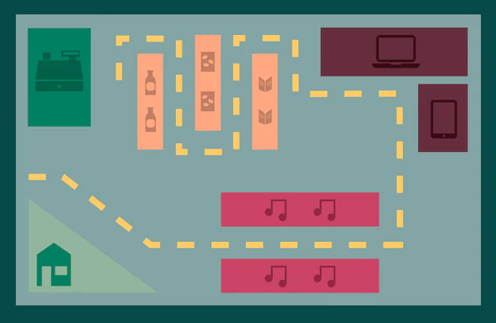
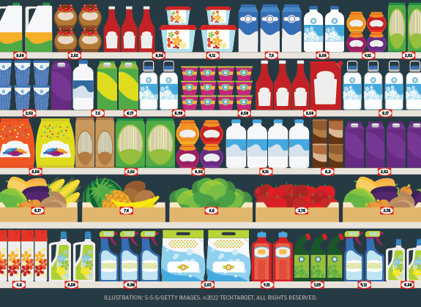
Retail Stores and Planograms
Planogram
How shelves and displays are arranged inside a store
How items are arranged inside shelves
Source: shopify.com
Source: techtarget.com
Notes:
https://www.shopify.com/in/retail/planogram-visual-merchandising
https://www.techtarget.com/whatis/definition/planogram

Slide 10
Business challenges in planogram design
Roles: Category Manager and Store Manager
Competing objectives
Frequent changes based on seasons
Travel to location
Labour for moving items and furniture
Multiple business priorities: Revenue, Margin, Visibility

Slide 11
Designing planograms using Generative AI
Prompt for Planogram Design
Product dimensions
Shelf dimensions
Product names
Business priority
High complexity
Hard coded data
Limit to how much data can be provided
Data relationships

Slide 12
Sample prompt
You are an expert planogram designer. I need your help in designing a planogram for a shelf, in a Retail Store in Bangalore. The shelf is in the chocolates aisle. The shelf has 5 columns and 4 rows. Each cell in the shelf can hold one chocolate box. So the shelf can hold a total of 5 x 4 = 20 chocolate boxes. The chocolate boxes are BarOne, KitKat, Munch and Milky bar. Munch has the highest market share. Milkybar has the highest margin share. KitKat is a core product. And BarOne is a newly launch product. I want to prioritize sales margin. It is very important that the returned planogram should be in the format given below. Do not leave any cell empty. Can you help me with the planogram design ? [["AAA", "AAA", "AAA", "AAA", "AAA"],
["AAA", "AAA", "AAA", "AAA", "AAA"],
["AAA", "AAA", "AAA", "AAA", "AAA"],
["AAA", "AAA", "AAA", "AAA", "AAA"]]

Slide 13
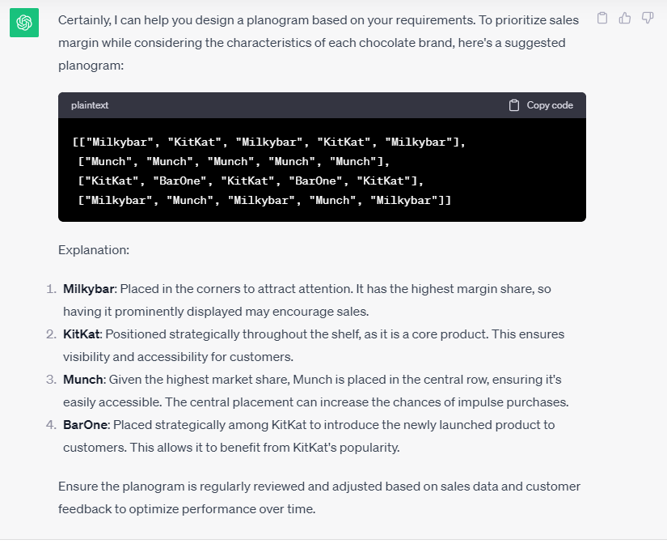

Slide 14
Challenges in Planogram design: Data relationships
Data relationships
Tabular
Hierarchical
Graphical

Slide 15
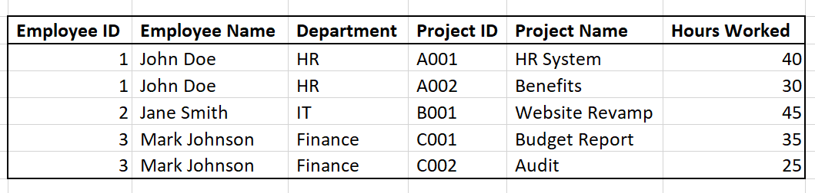
Tabular data sets

Slide 16
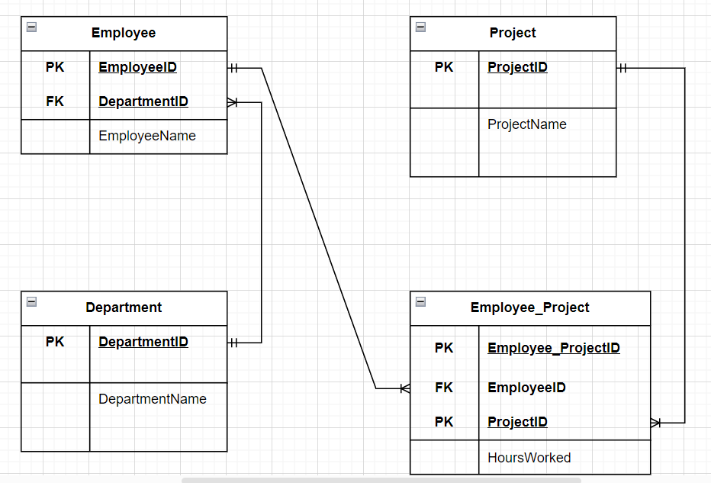
Hierarchical and Graphical data sets

Slide 17
The solution
For connecting the data to the LLM
Provide the data in the context
Use multiple iterations of calls: function calling
For understanding the semantics
Easier way: Convert tabular data to json format
Harder way: Convert tabular data to descriptive text format

Slide 18
Sample prompt again
You are an expert planogram designer. I need your help in designing a planogram for a shelf, in a Retail Store in Bangalore. The shelf is in the chocolates aisle. The shelf has 5 columns and 4 rows. Each cell in the shelf can hold one chocolate box. So the shelf can hold a total of 5 x 4 = 20 chocolate boxes. The chocolate boxes are BarOne, KitKat, Munch and Milky bar. Munch has the highest market share. Milkybar has the highest margin share. KitKat is a core product. And BarOne is a newly launch product. I want to prioritize sales margin. It is very important that the returned planogram should be in the format given below. Do not leave any cell empty. Can you help me with the planogram design ? [["AAA", "AAA", "AAA", "AAA", "AAA"],
["AAA", "AAA", "AAA", "AAA", "AAA"],
["AAA", "AAA", "AAA", "AAA", "AAA"],
["AAA", "AAA", "AAA", "AAA", "AAA"]]

Slide 19
Response for Margin priority
[["Milkybar", "KitKat", "Milkybar", "KitKat", "Milkybar"],
["Munch", "Munch", "Munch", "Munch", "Munch"],
["KitKat", "BarOne", "KitKat", "BarOne", "KitKat"],
["Milkybar", "Munch", "Milkybar", "Munch", "Milkybar"]]

Slide 20
Sample prompt without hardcoded data
You are an expert planogram designer. I need your help in designing a planogram for a shelf, in a Retail Store in Bangalore. The shelf is in the chocolates aisle. The shelf has 5 columns and 4 rows. Each cell in the shelf can hold one chocolate box. So the shelf can hold a total of 5 x 4 = 20 chocolate boxes. The chocolate boxes are BarOne, KitKat, Munch and Milky bar. Munch has the highest market share. Milkybar has the highest margin share. KitKat is a core product. And BarOne is a newly launch product. I want to prioritize sales margin. It is very important that the returned planogram should be in the format given below. Do not leave any cell empty. Can you help me with the planogram design ? [["AAA", "AAA", "AAA", "AAA", "AAA"],
["AAA", "AAA", "AAA", "AAA", "AAA"],
["AAA", "AAA", "AAA", "AAA", "AAA"],
["AAA", "AAA", "AAA", "AAA", "AAA"]]

Slide 21
Data for function calling
{
"sales_info": {
"market_share_percentage": {
"Munch": 40,
"Milky bar": 30,
"KitKat": 20,
"BarOne": 5
},
"margin_share_percentage": {
"Munch": 6,
"Milky bar": 15,
"KitKat": 10,
"BarOne": 12
},
"core_product": {
"Munch": "No",
"Milky bar": "No",
"KitKat": "Yes",
"BarOne": "No"
},
"new_product": {
"Munch": "No",
"Milky bar": "No",
"KitKat": "No",
"BarOne": "Yes"
}
}
}

Slide 22
Margin share priority
[["Milky bar", "Milky bar", "Milky bar", "Milky bar", "Milky bar"],
["BarOne", "BarOne", "BarOne", "BarOne", "BarOne"],
["KitKat", "KitKat", "KitKat", "KitKat", "KitKat"],
["Munch", "Munch", "Munch", "Munch", "Munch"]]
"margin_share_percentage": {
"Munch": 6,
"Milky bar": 15,
"KitKat": 10,
"BarOne": 12
},

Slide 23
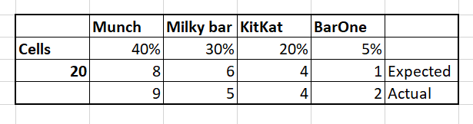
Market share priority
[["Munch", "Munch", "Munch", "Munch", "Munch"],
["Munch", "Munch", "Munch", "Munch", "Milky bar"],
["Milky bar", "Milky bar", "Milky bar", "Milky bar", "KitKat"],
["KitKat", "KitKat", "KitKat", "BarOne", "BarOne"]]
"market_share_percentage": {
"Munch": 40,
"Milky bar": 30,
"KitKat": 20,
"BarOne": 5
},

Slide 24
Lets see some code now
Planogramdesign_function_calling.ipynb

Slide 25
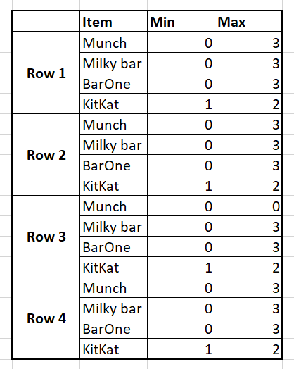
Lets add more complexity ☺
Add constraints for chocolate placements
These constraints are actual planogram rules
Response from gpt-4-1106-preview:
[["KitKat", "KitKat", "Munch", "Munch", "Munch"],
["KitKat", "KitKat", "Munch", "Munch", "Munch"],
["KitKat", "KitKat", "Milky bar", "Milky bar", "BarOne"],
["KitKat", "KitKat", "Munch", "Munch", "Munch"]]

Slide 26







Gold Partner
Silver Partner

Slide 28
Prajod Vettiyattil
https://www.linkedin.com/in/prajod/
@prajods
https://github.com/prajod

